Slide 1
HR ANALYTICS
Employee Retention

Slide 2

Agenda
Introduction
Problem Statement
Business Objective
KPIS
DashBoard
9. Conclusion

Slide 3


Introduction
HR analytics involves the collection and analysis o HR-related data, including employee data, performance metrics, and other relevant data points. By using advanced analytical tools and techniques, HR analytics provides valuable insigh into HR processes and trends, enabling organizations to make more informed decisions about their employees and improve overall performance.
HR analytics involves the collection and analysis of HR-related data, including employee data, performance metrics, and other relevant data points. By using advanced analytical tools and techniques, HR analytics provides valuable insights into HR processes and trends, enabling organizations to make more informed decisions about their employees and improve overall performance.

Slide 4


Problem Statement- KPI’s
Average attrition rate for all Departments Average hourly rate of Male Research Scientist
Attrition rate Vs Monthly Income stats
Average working years for each Department Job role Vs Work life balance
Attrition rate Vs Years Since last promotion

Slide 5


Business Objective
The aim of this project is to analyze employee retention
and attrition rates with the organization and provide insights to the HR team for developing effective retention strategies. Through data analysis and visualizations, we will identify factors that contribute to :
Employee turnover and attrition.
Evaluate the effectiveness of existing retention strategies. To verify the satisfaction level of employee in the organization.
Provide recommendations to improve employee retention.

Slide 6

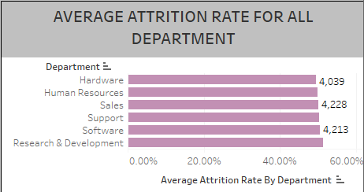
KPI - 1
Average attrition rate for all Department
Insights from KPI 1:
We can clearly say that attrition rate of employees for every department is almost 50% which indicates that attrition rate of employees does not depends on department. So, irrespective of the department almost 50% of employees are leaving the company.
From this calculation and visualization we concluded that we must make strong strategies to minimize attrition rate and improve our company’s Employee retention so that we can balance the company’s growth and right talent.

Slide 7

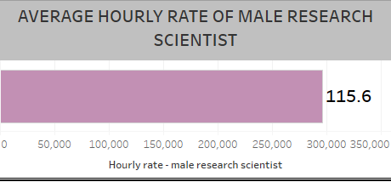
KPI - 2
Average Hourly rate of Male Research Scientist
Insights from KPI 2 :
This KPI is to find out the average hourly rate of male research scientists which is 115.6

Slide 8

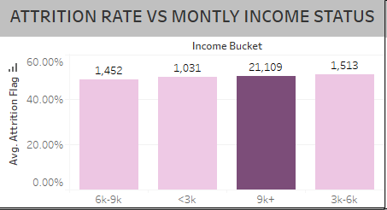
KPI –3 Attrition Rate Vs Monthly Income Stats
Insights from KPI 3 :
This chart highlights that employees in the ₹6k–₹9k monthly income bracket exhibit the highest attrition rate compared to other income groups. Interestingly, employees earning less than ₹3k or more than ₹9k have lower attrition rates, suggesting that mid-income earners are more dissatisfied or have better alternative opportunities.

Slide 9

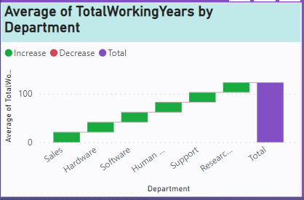
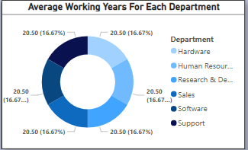
KPI - 4
Average Working Years for each Department
Insights from KPI 4:
From this we can see the average working years in software department is high as compared to the rest of the departments and lowest is for Research & Development Department.
From the analysis we can conclude that average working years is
approximately 20 for all the
departments.

Slide 10

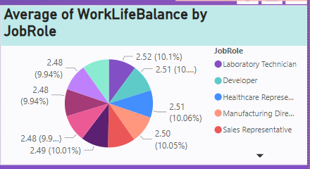
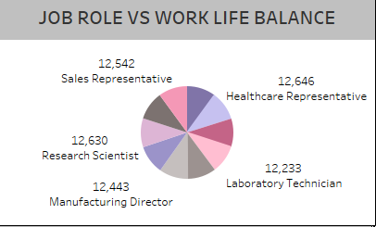
KPI - 5 Job Role Vs Work Life Balance for Total Employees
Insights from KPI 5:
The pie chart shows that Sales Representatives, Healthcare Representatives, and Research Scientists are the top three roles in terms of headcount. Despite varying nature of roles, the work-life balance metric seems evenly distributed, suggesting no particular role is significantly outperforming others in terms of balance.

Slide 11
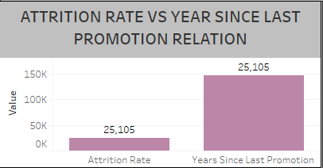
KPI –3 Attrition Rate Vs Year Since Last Promotion
Insights from KPI 6 :
This bar chart compares the attrition count against the number of years since an employee's last promotion. A key observation is that a high number of employees who haven't been promoted recently also contribute to a significant portion of the attrition count.

Slide 12
SQL
Structured Query Language (SQL) played a foundational role in preparing the HR dataset for analysis. It was used to extract, clean, and transform raw employee data stored in relational databases. Key operations included:
Data Cleaning: Filtering out nulls, duplicates, and inconsistent job or department entries.
Aggregation & Calculations: Calculating department-wise attrition rates, average tenure, hourly compensation, and identifying last promotion years using GROUP BY, AVG(), DATEDIFF(), and CASE statements.
Segmentation: Creating income buckets, tenure brackets, and gender/job role filters using CASE and WHERE clauses for dashboard interactivity.
SQL ensured that only high-quality, structured data was passed into Power BI, enabling accurate visualizations and insights. It formed the backbone of our data pipeline, allowing for scalable and repeatable analytics.

Slide 13
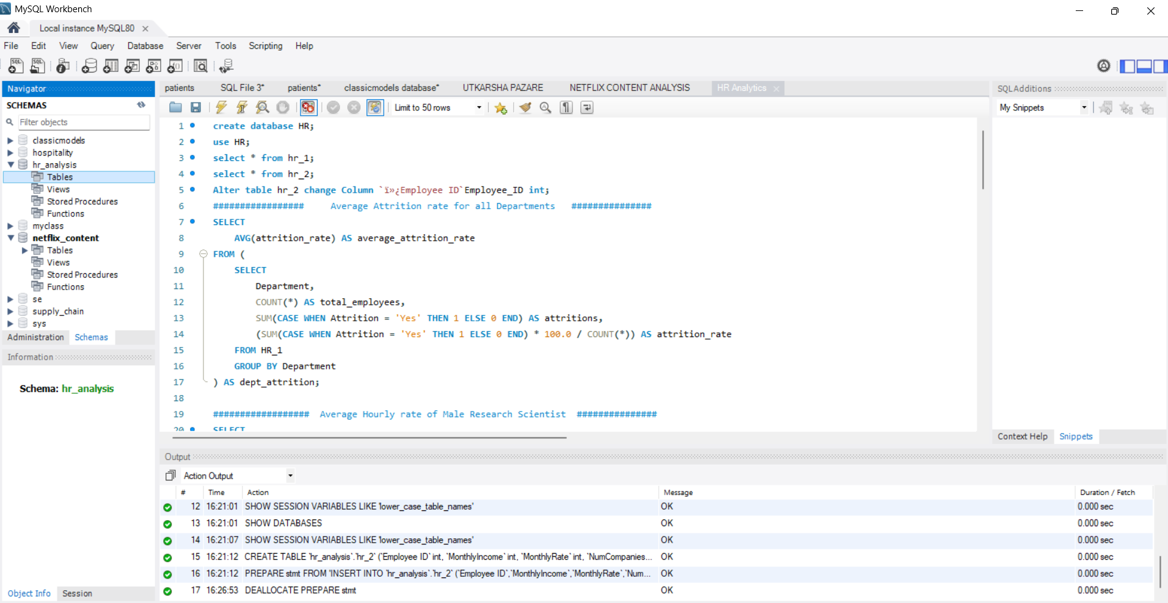

Slide 14
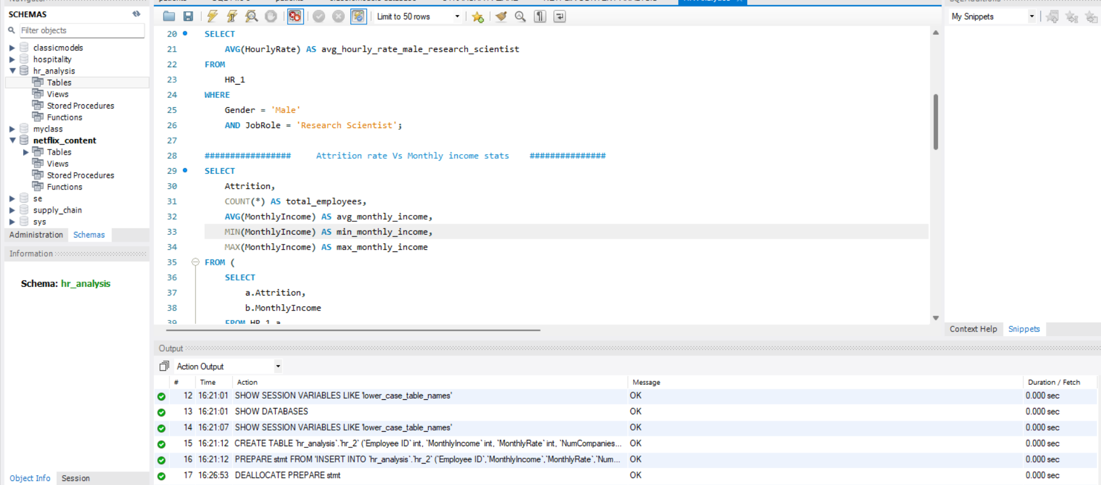

Slide 15
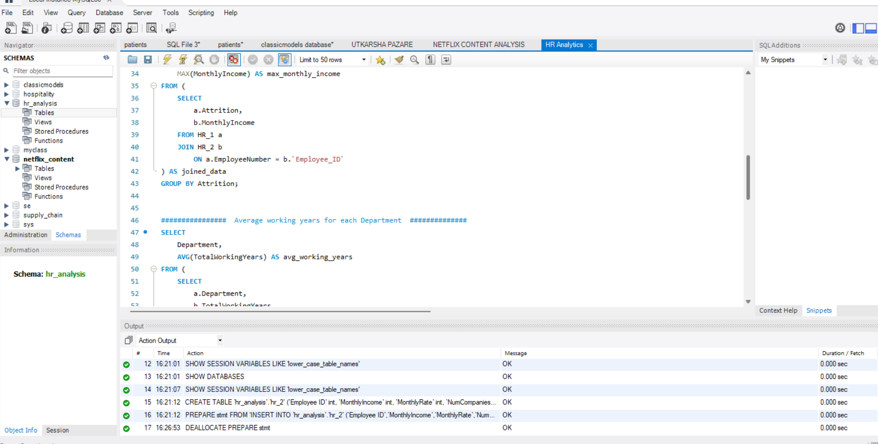

Slide 16
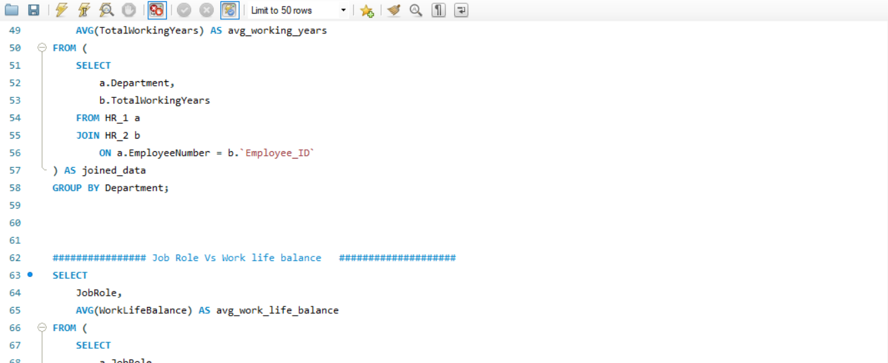

Slide 17
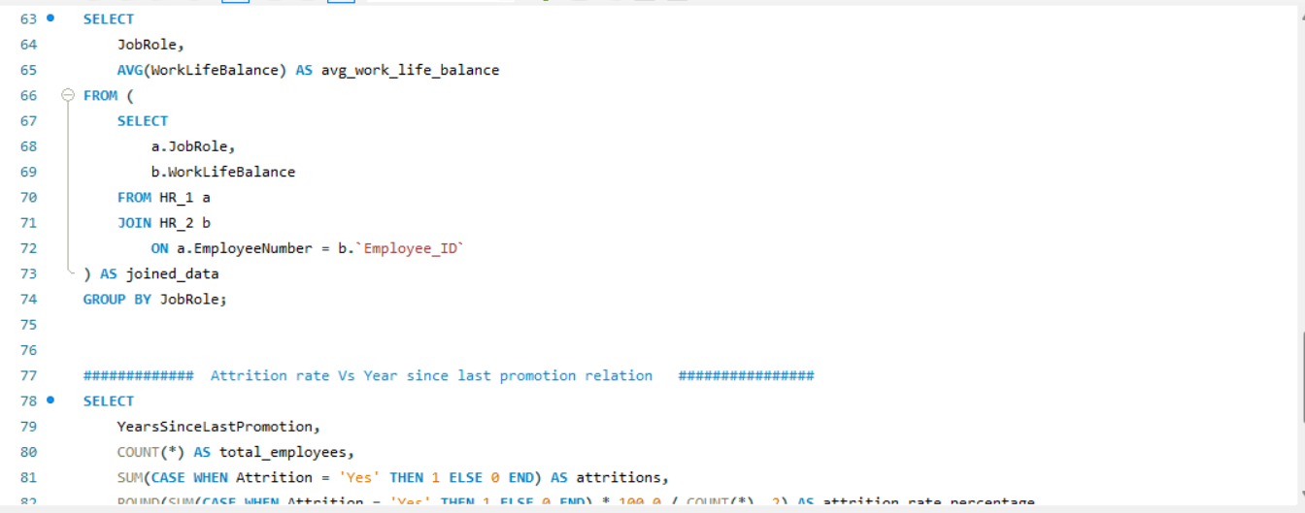

Slide 18
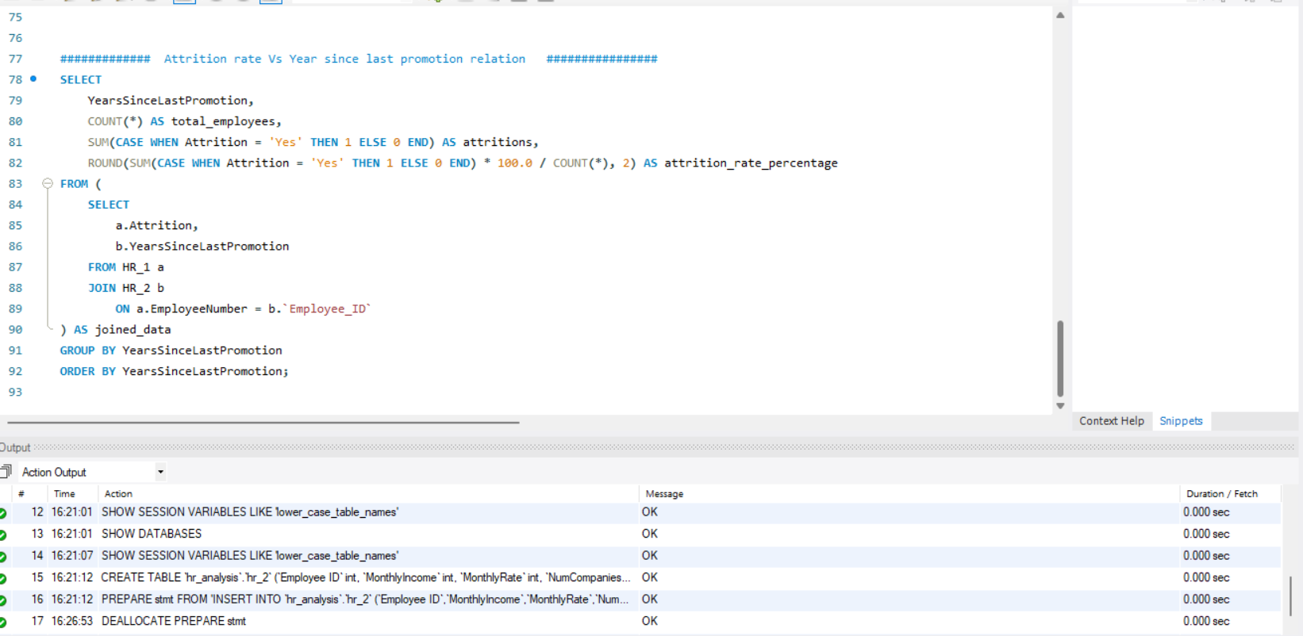

Slide 19
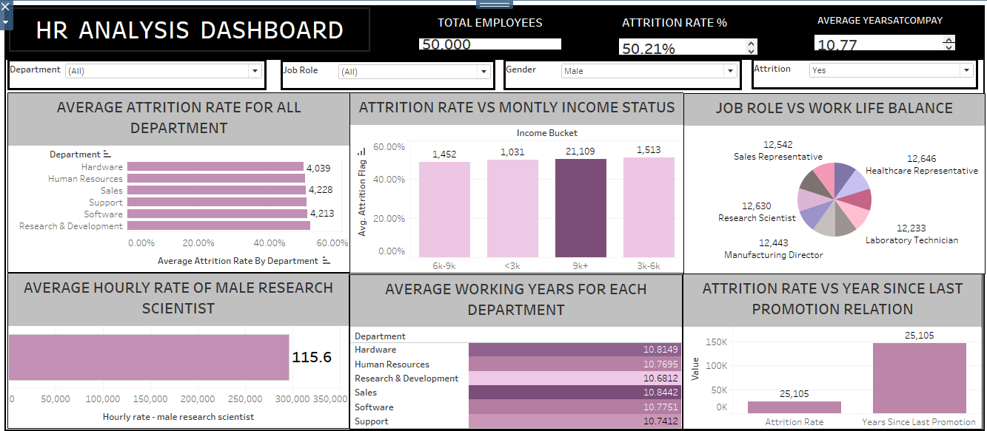

Slide 20
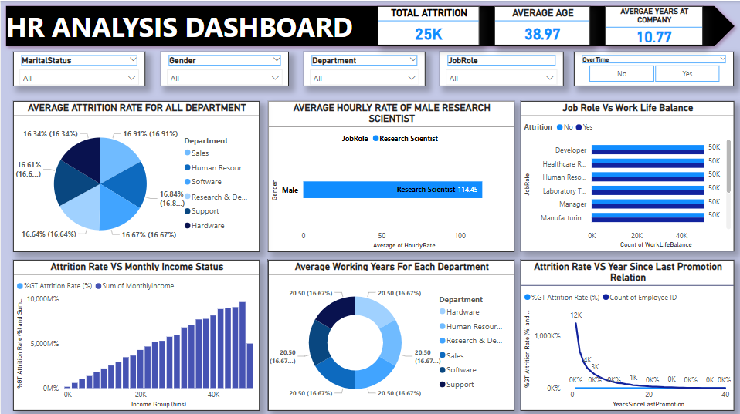

Slide 21
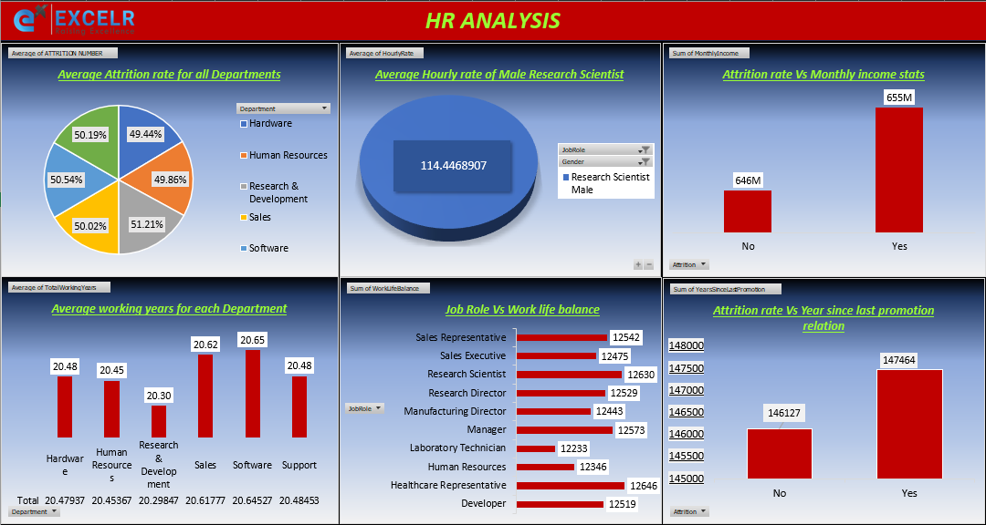

Slide 22

The dashboard reveals serious challenges around employee attrition, particularly in Research & Development, Sales, and mid-income employees. Despite long average tenures, high turnover persists, likely due to unmet career advancement expectations and unclear reward structures.
To address this, the company should prioritize improving internal promotion pathways, ensuring pay equity, and revisiting workload or recognition systems in high-turnover departments. Regular employee engagement surveys and personalized development plans could further enhance retention and morale.

Slide 23


